Slide 1

Building a Static Website for a Restaurant Using AWS
Praesignis AWS re/Start Program Project 1 – AWS Special: Static Website & Migration Benefits Presented by: Group 3

Slide 2
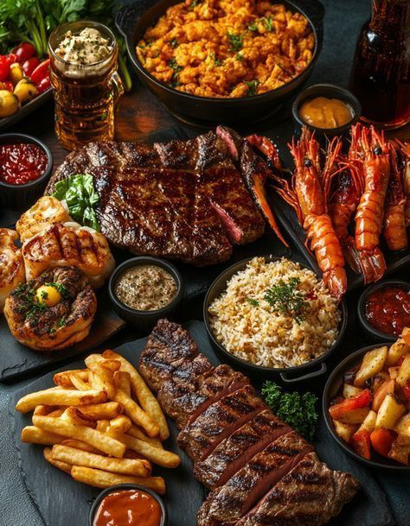
About Taste of Africa
Overview: Taste of Africa is a local restaurant that brings together authentic African dishes, rich flavors, and warm hospitality. The restaurant celebrates African culture through its food and dining experience.
Operations: The business receives a high volume of customer bookings and orders every day, both in-person and by phone. However, the manual paper-based system has led to confusion, double bookings, and lost orders.
Purpose of the Project: To introduce a simple AWS-hosted website that helps customers make online bookings and orders reducing errors, improving efficiency, and enhancing the overall experience.

Slide 3
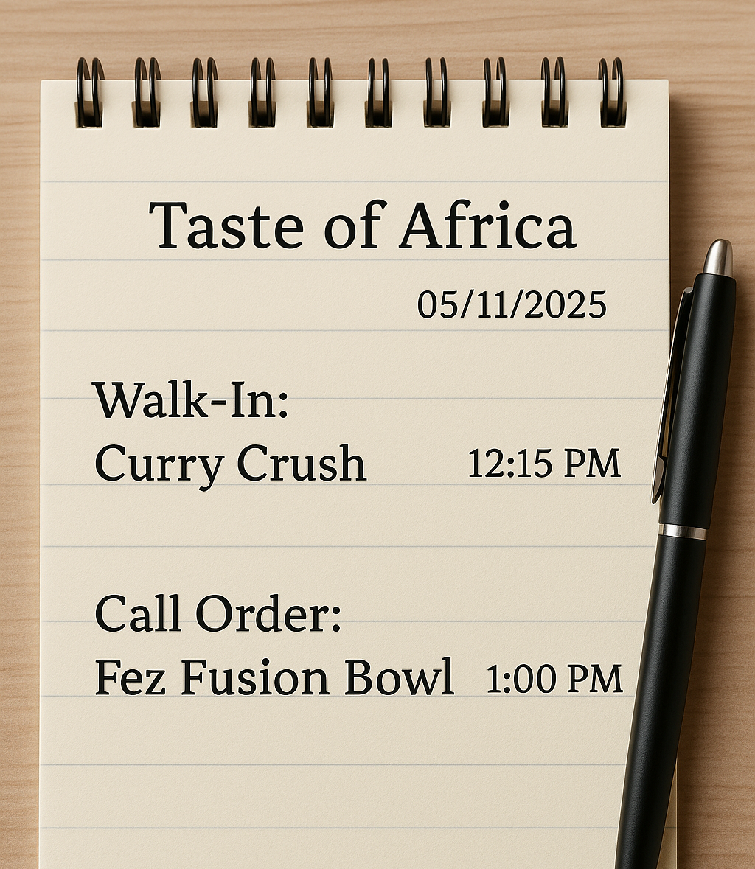
Challenges
Manual System The restaurant still uses paper and phone bookings, which often leads to confusion and mix-ups.
Frequent Errors Orders get lost or duplicated, and double bookings happen because there’s no online record system.
No Centralized Data Customer information and preferences aren’t stored anywhere, making it hard to identify repeat customers.
Expensive to Scale Managing more customers means hiring extra staff or buying new computers both costly and time-consuming.

Slide 4
Project Goal
Main Goal: To design and host a simple, user-friendly website for Taste of Africa using Amazon S3.
Objectives:
Replace the manual paper system with an online booking and ordering platform.
Reduce order mix-ups and double bookings through digital tracking.
Improve efficiency and customer experience using cloud technology.
Demonstrate how AWS can provide a low-cost, scalable solution for small businesses.

Slide 5
Website Features
Home Page: Introduces Taste of Africa with a short description, slogan, and welcoming images.
Menu Page: Displays dishes, prices, and meal photos so customers can easily browse.
Booking Page: Includes a simple online form for customers to make table reservations.
Contact Page: Shows contact details, location, and a message box for inquiries.
Design Style: Uses African-inspired colors brown, gold, and white for a warm and modern feel.

Slide 6

AWS Services Used
Amazon S3 (Simple Storage Service): Used to host our static website and store images, CSS, and HTML files. It makes the site accessible to customers anytime, without a traditional server.
IAM (Identity and Access Management): Used to create and manage user permissions safely. Helps ensure only authorized users can edit or upload website files.
CloudWatch: Used to monitor website availability and performance for future improvements.

Slide 7
Benefits of AWS
Low Cost AWS Free Tier allows the restaurant to host the website at almost no cost.
Reliability The site stays available 24/7, giving customers constant access to bookings and menus.
Security IAM ensures only authorized users can manage the website files.
Scalability As the business grows, AWS can easily handle more traffic without extra hardware.
Simplicity AWS services are easy to use and reduce the need for technical staff.

Slide 8
Cost Comparison
Feature / Expense | Manual System (Old Way) | AWS Cloud (New Way)
System Setup | Requires computers, paper records, and software | Free to host using AWS S3 Free Tier
Maintenance | Needs IT support and upgrades | No maintenance required
Data Storage | Kept in files or on local computers | Stored securely in the cloud
Accessibility | Only in-store | Accessible online anytime
Cost | High and ongoing | Very low and pay-as-you-go

Slide 9
Team Learning
Learned how to create and host a website using Amazon S3.
Gained experience in setting bucket policies and managing access with IAM.
Explored how CloudWatch helps monitor website performance.
Improved teamwork, communication, and project coordination.
Understood how AWS helps small businesses solve real challenges.

Slide 10

Conclusion
AWS helped us solve the restaurant’s real business challenges.
Using Amazon S3, we hosted a live website that replaces manual systems.
IAM and CloudWatch made the setup secure, reliable, and easy to manage.
The project shows how cloud technology can help small businesses grow with low costs and high efficiency.
Thank You! 🙏

